Slide 1
Hospital Management System
Sri Vidya veggalapu-EBEON0722630563
Katyayani Kommoju-EBEON0722629133
K Asha Nandini-EBEON0722628531
Vedita Mhatre-EBEON0722627266
Guided by
Varadharajan A

Slide 2
Hospital Management System
Admin
Doctor
Patient
Pharmacy Management System
Inventory
Laboratory
Appointment

Slide 3
Hospital Management System
Pharmacy module contains list of medicines and we can also add medicines.
Payment module will do the payment process.

Slide 4
Pharmacy
The main objective of a pharmacy module is to delivery of drugs in a hospital or medical center.
This allows doctors to prescribe drugs presently in stock.

Slide 5
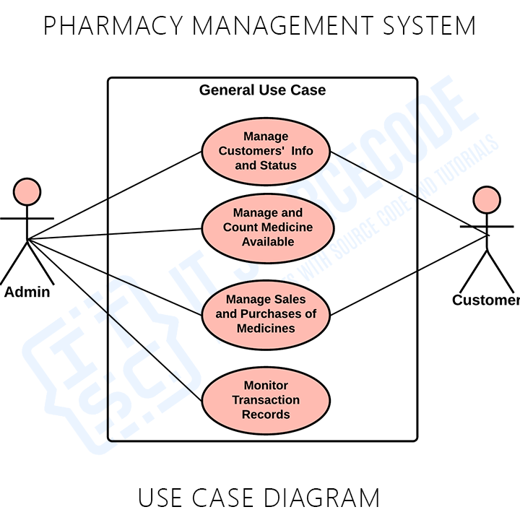
Pharmacy overview

Slide 6
Payment
We'll learn how to use Paytm as a payment gateway in our spring boot application.
And provides receipt.

Slide 7
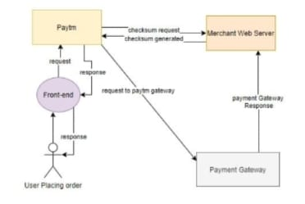
Payment overview

Slide 8
Challenging issues
I have faced many errors during the development of my project. I resolved it by some sources in the Google and tried it in my project.
I have also faced import errors, dependencies errors solved these using google.

Slide 9
Features about the module
1.Pharmacy Module:
This enables the admin to login, view the list of the medicines and add medicines in the database. It helps in managing all the data of the medicines.
2.Payment Module:
This enables patient’s to make payment through web using paytm.
Payment module uses merchant id and key.

Slide 10
Future enhancement
It is used in hospital and medical centre.
It has been one of the IT-systems, which helps pharmacists improve the supply, cost, health, safety, security, etc.
But there are still some jobs left which we will do in the future. Some works like –
1. Appointment to the doctor system.
2. Pharmacy safety system.

Slide 11
Conclusion
Pharmacy and payment are one of the important modules in hospital management system.

